Slide 1

Fire Damper process workbook
V1 DEC 2023

Slide 2













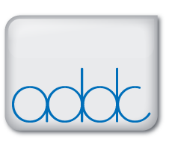




A unique non-for-profit initiative comprising major contractors, specialist installers and relevant trade associations
A collaborative forum to drive culture change through the design and construction process to improve fire safety in buildings
Our mission is to improve the delivery of well designed, specified and installed passive fire protection by focusing on 3 key areas:
Process, Testing and Education.

Slide 3
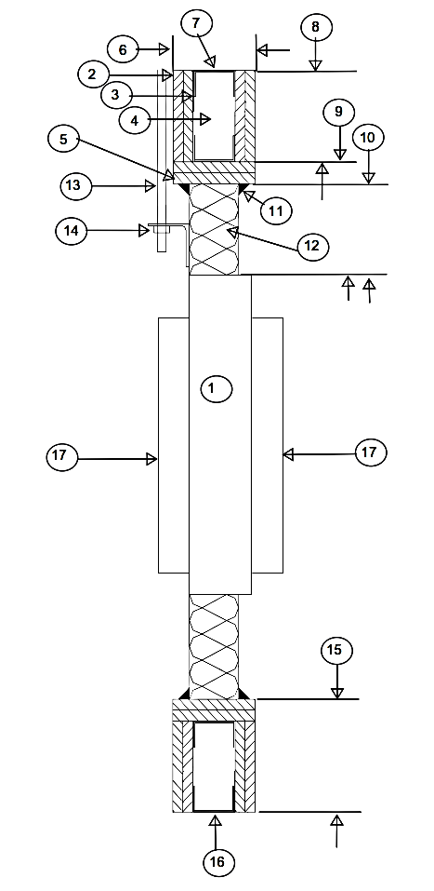
Objective – FIRE DAMPERs
The objective of this presentation is to illustrate a best practice approach to the design and specification of Fire Dampers and their associated services penetration seals where they pass through fire compartment walls or floors.
The aim is to give the reader an understanding of the process required to ascertain the route to achieve an appropriate fire damper, compatibility of the fire wall or floor system and the access arrangements for installation, digital recording and future maintenance
The output of the process will produce the classification of the fire damper for selection.

Slide 4
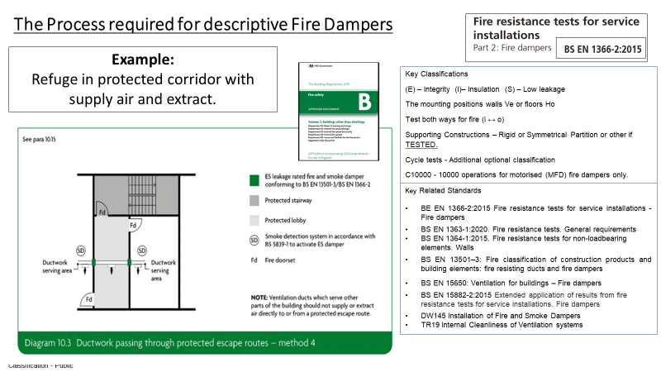
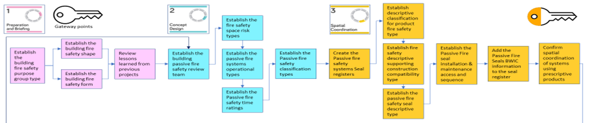
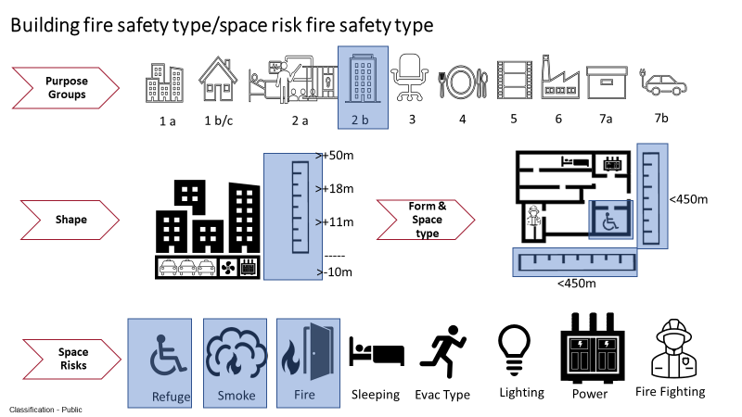
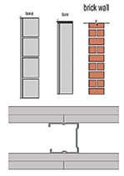
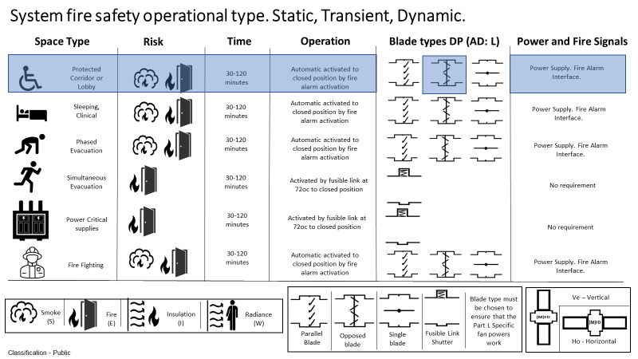
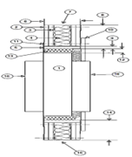
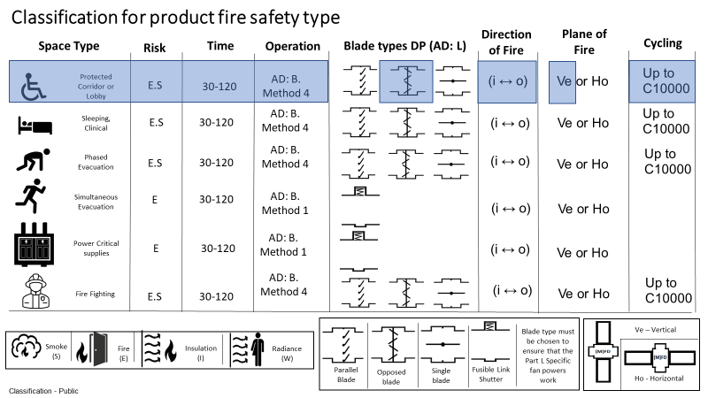
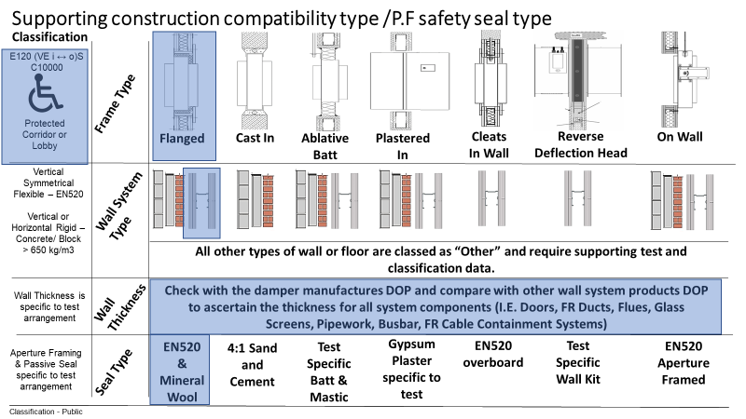

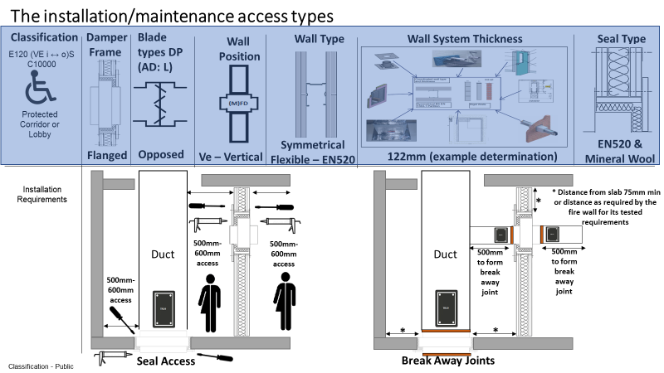

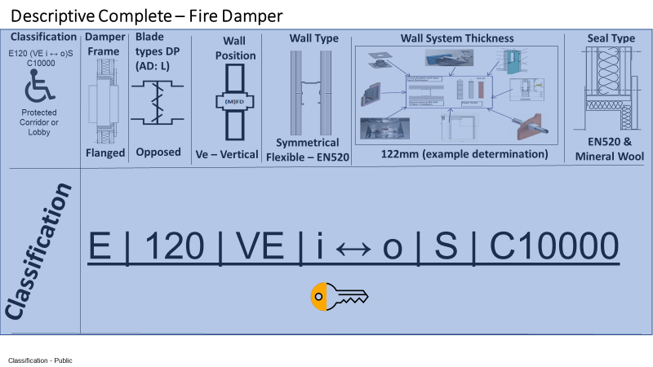

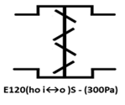


Fire Damper Work Book Example
Passive code

Slide 5
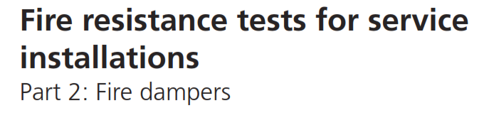

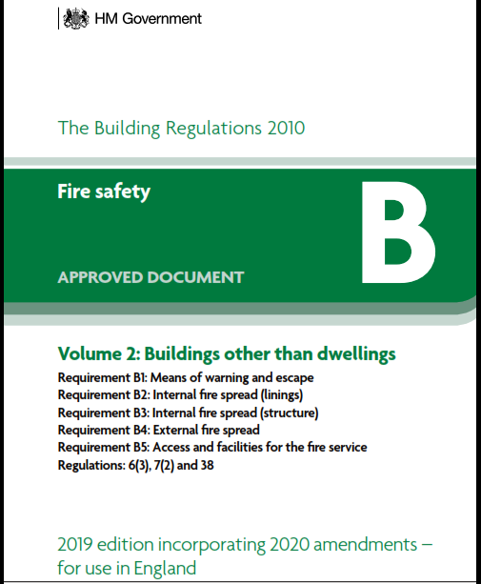
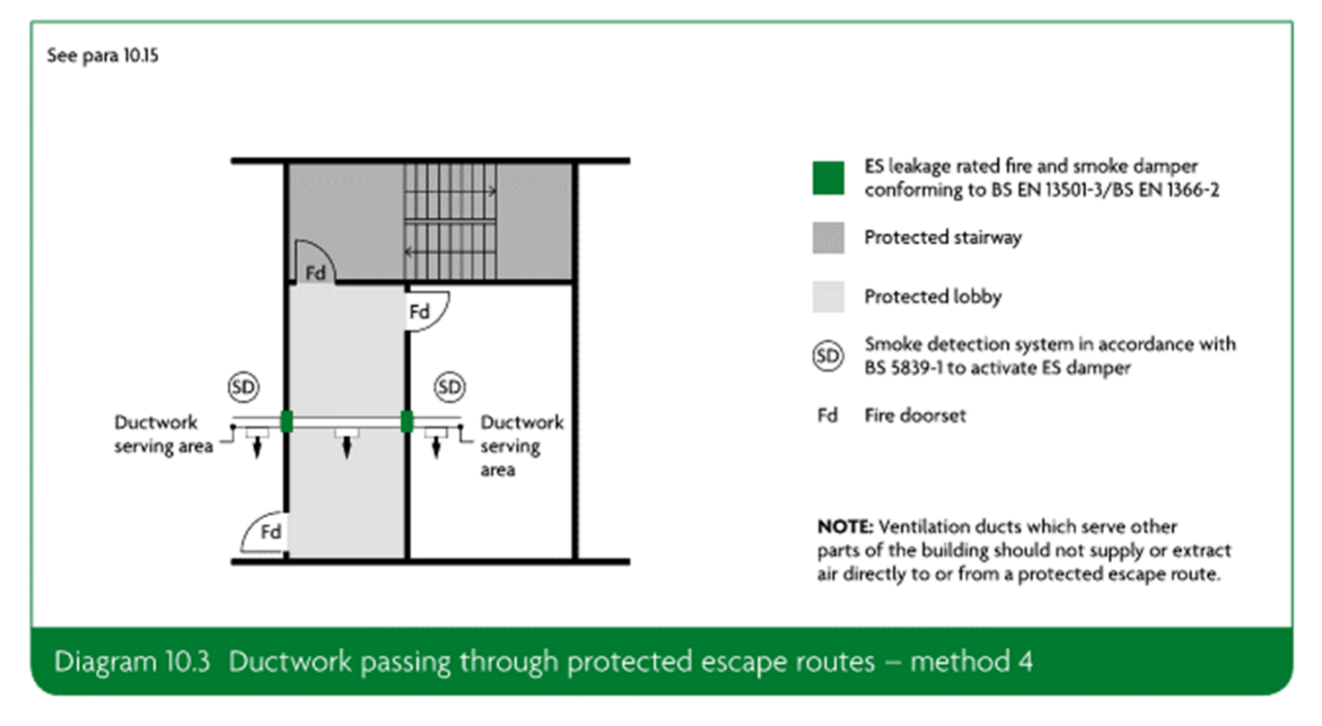
The Process required for descriptive Fire Dampers
Example:
Refuge in protected corridor with supply air and extract.
Key Classifications
(E) – Integrity (I)– Insulation (S) – Low leakage
The mounting positions walls Ve or floors Ho
Test both ways for fire (i ↔ o)
Supporting Constructions – Rigid or Symmetrical Partition or other if TESTED.
Cycle tests - Additional optional classification
C10000 - 10000 operations for motorised (MFD) fire dampers only.
Key Related Standards
BE EN 1366-2:2015 Fire resistance tests for service installations - Fire dampers
BS EN 1363-1:2020. Fire resistance tests. General requirements
BS EN 1364-1:2015. Fire resistance tests for non-loadbearing elements. Walls
BS EN 13501–3: Fire classification of construction products and building elements: fire resisting ducts and fire dampers
BS EN 15650: Ventilation for buildings – Fire dampers
BS EN 15882-2:2015 Extended application of results from fire resistance tests for service installations. Fire dampers
DW145 Installation of Fire and Smoke Dampers
TR19 Internal Cleanliness of Ventilation systems
Notes:
Paul to change images

Slide 6
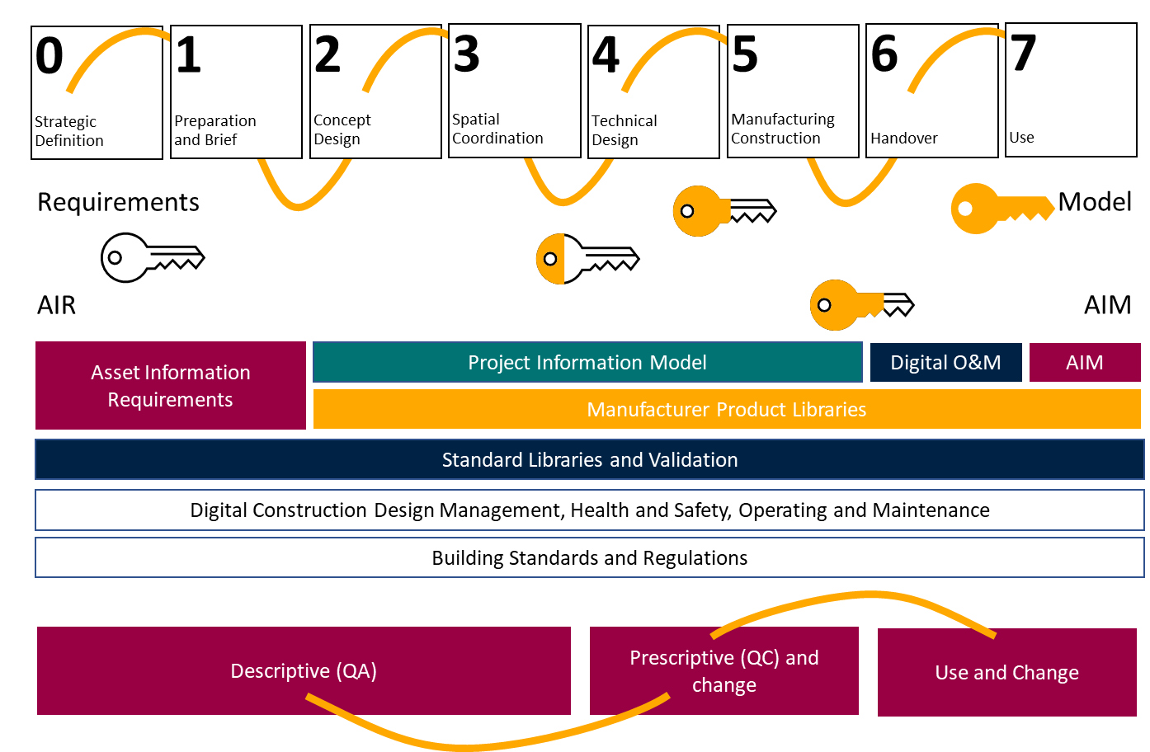
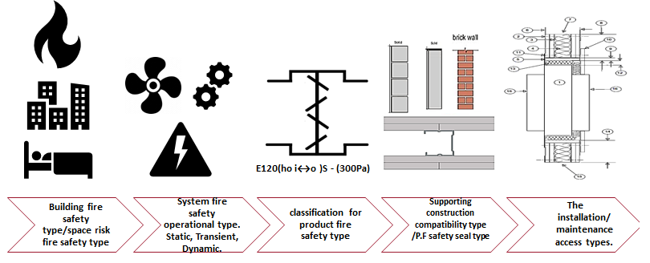
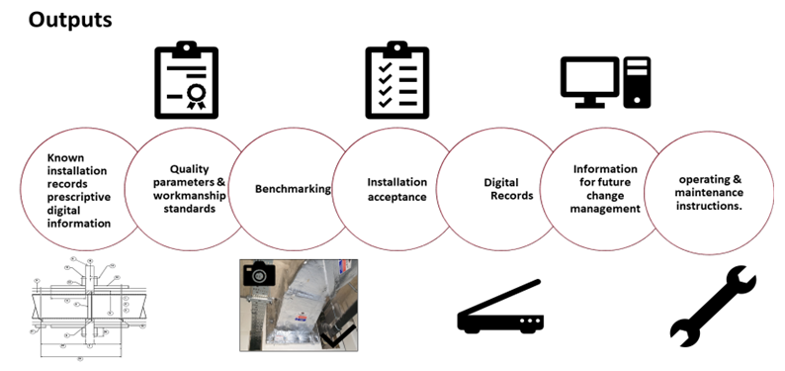
Gateways

Slide 7
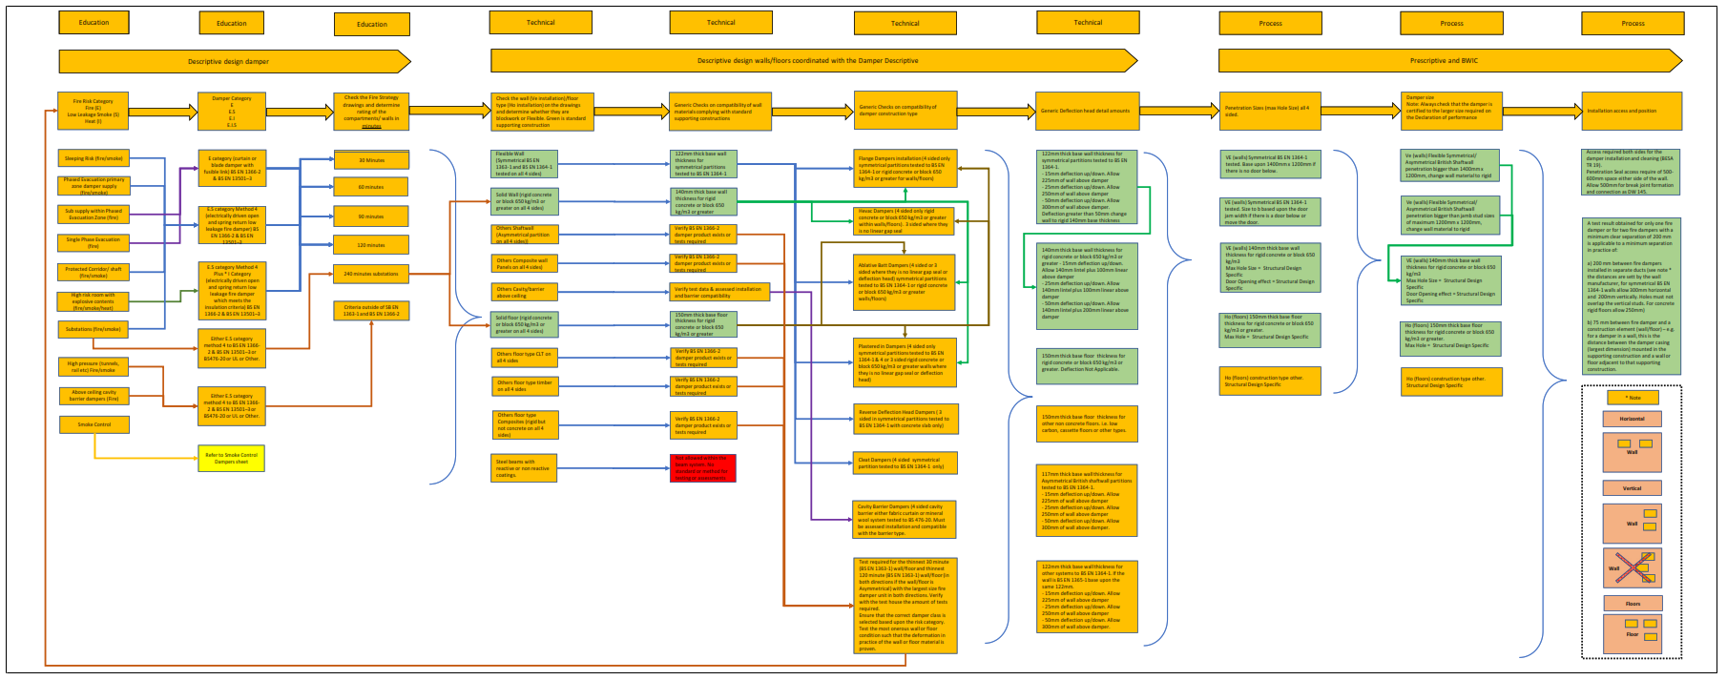
The Process required for descriptive Fire Dampers.
Its Complicated

Slide 8
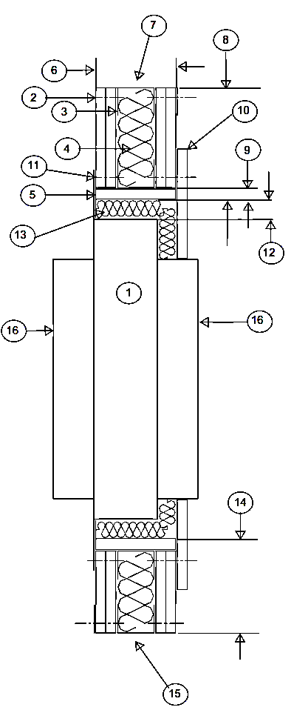






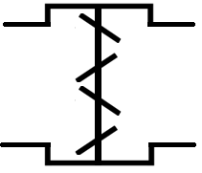
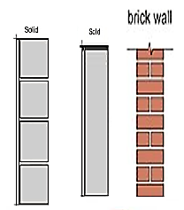
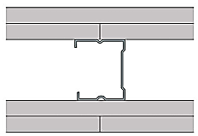
The Process required for descriptive Fire Dampers.
Simplification of the below flow diagram follows.
E120(ho i↔o )S - (300Pa)
Building purpose group/fire safety space risk
System fire safety operational type. Static, Transient, Dynamic.
classification for product fire safety type
Supporting construction compatibility type /P.F safety seal type
The installation/maintenance access types.
Simplify It!!!

Slide 9
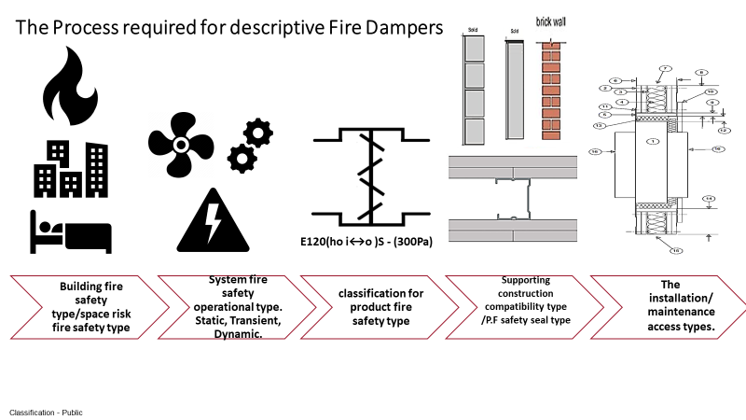
TECHNICAL Quality Assurance. Setting of the appropriate product for the circumstances. Any change is ‘major’ once this has been formulated.
**Building Regulations Functional Requirements, Approved Documents: Part L, O, F, B.
* Culmination of all product types to verify the appropriate wall type.

Slide 10
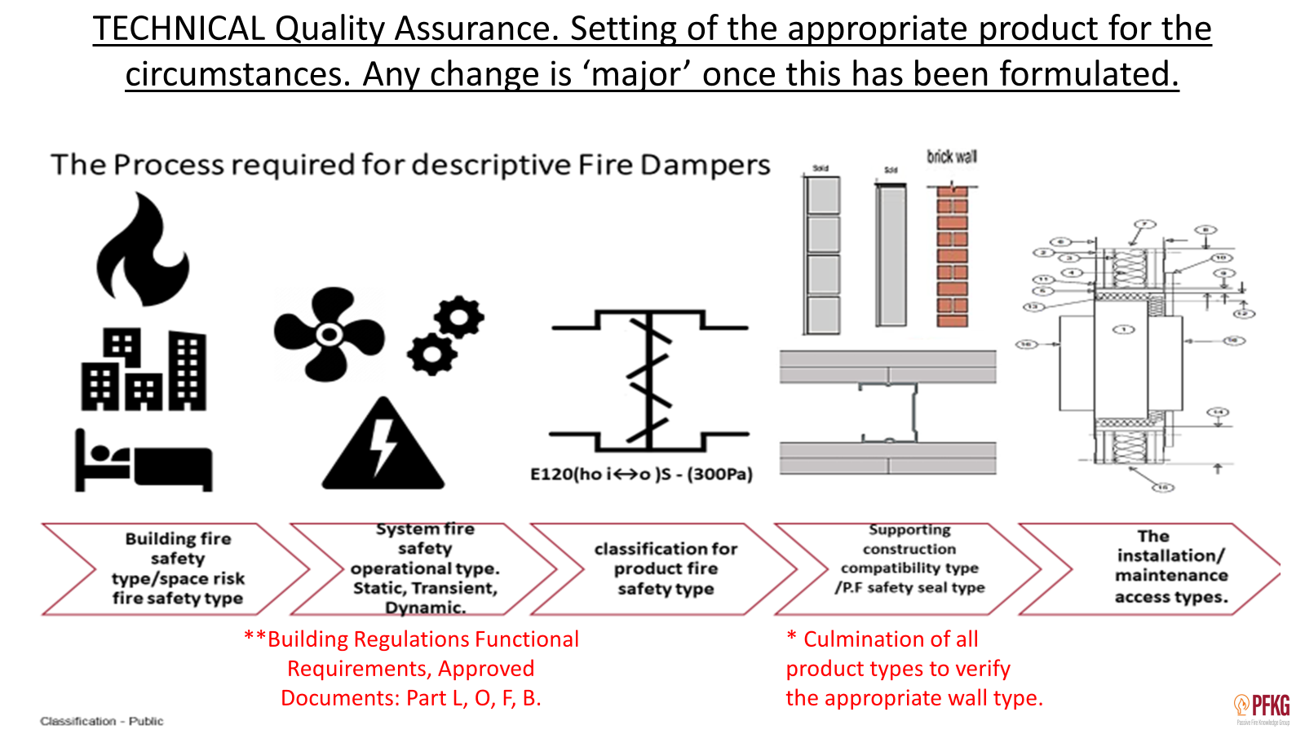

**Design of system to components to meet all functional requirements of the Building Regulations
Operational type**. Building Regulations Functional Requirements, Approved Documents: Part L, O, F, B.
Part L. Evidence that the system energy performances are within the limits of the calculated performance.
Part O. Evidence that the system performance will prevent overheating where designed to do so.
Part F. Evidence that the system performance will supply reasonable levels of ventilation.
Part B. Evidence that the systems fire prevention devices do not impeded Parts, L, O, F and meet the space risk requirements

Slide 11
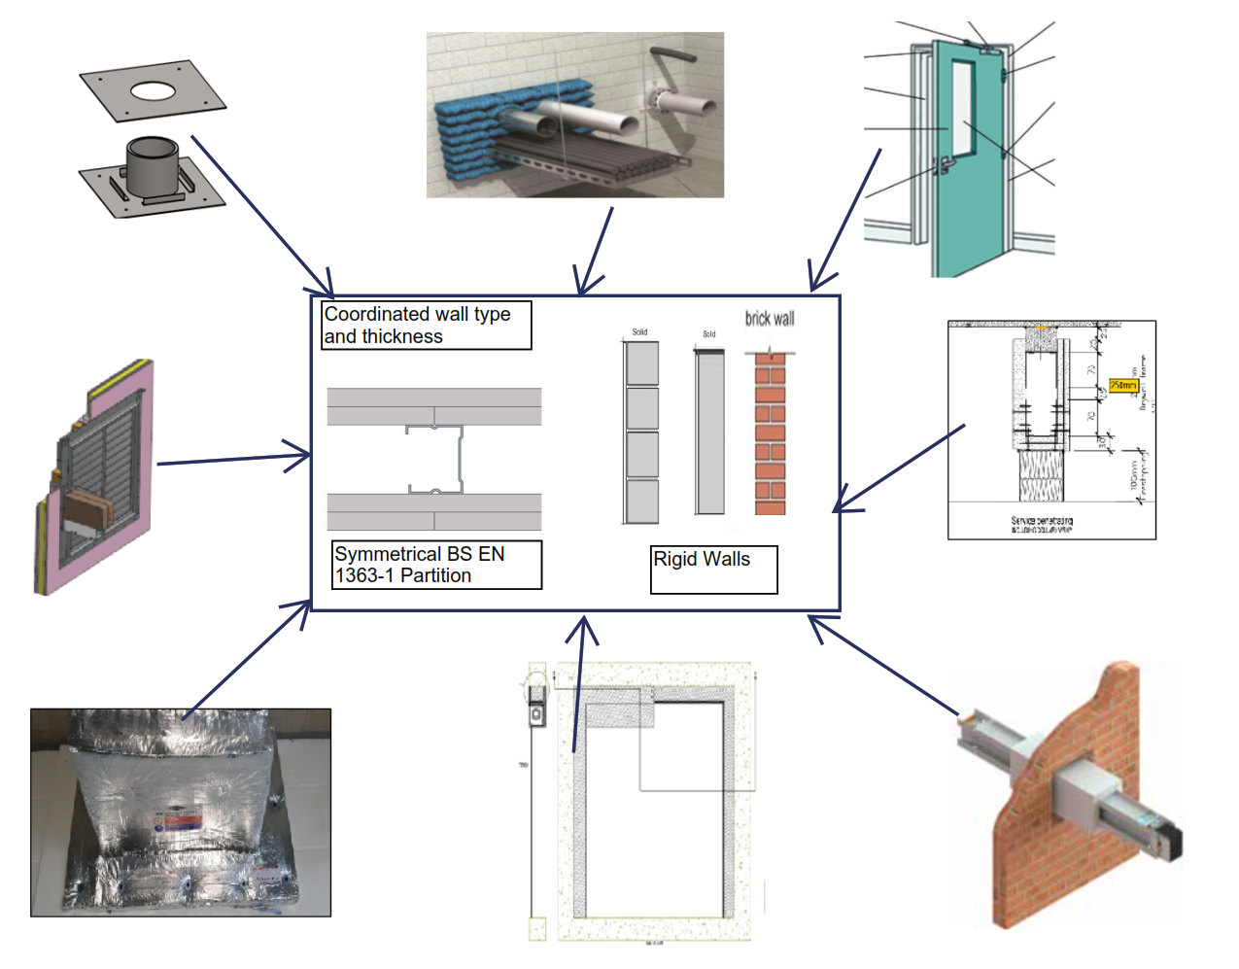
* Culmination of all product types to verify the appropriate wall type. System approach
Pipes & Trays
Fire Doors
Lift Doors
Flues
Fire Dampers
Smoke Control Dampers
Wall Types
Fire Resistant Ducts Smoke extract ducts
Cable Encapsulation
Fire Curtains
Busbars

Slide 12
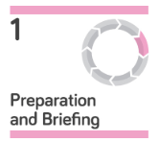

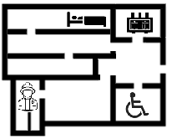
The Process required for descriptive Fire Dampers
Building purpose group/fire safety space risk .
Establish the fire safety space risk types
Gateway points
Establish the building fire safety shape
Establish the building fire safety purpose group type
Review lessons learned from previous projects
Establish the building passive fire safety review team
Establish the building fire safety form
System fire safety operational type. Static, Transient, Dynamic.
Example:
Refuge in protected corridor with supply air and extract. Mark in blue.
Notes:
Suggest zone in

Slide 13












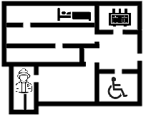









Building purpose group/fire safety space risk
Purpose Groups
1 a
1 b/c
2 a
2 b
3
4
5
6
7a
7b
Shape
Form & Space type
Space Risks
Refuge
Smoke
Fire
Sleeping
Evac Type
Lighting
Power
Fire Fighting
Notes:
Paul to change images

Slide 14
Building purpose group/fire safety space risk
Purpose Groups
1 a
1 b/c
2 a
2 b
3
4
5
6
7a
7b
>+50m
>+18m
>+11m
-----
>-10m
Shape
Form & Space type
<30m
<30m
Space Risks
Refuge
Smoke
Fire
Sleeping
Evac Type
Lighting
Power
Fire Fighting
Notes:
Paul to change images

Slide 15
The Process required for descriptive Fire Dampers
System fire safety operational type. Static, Transient, Dynamic.
Building purpose group/fire safety space risk
Establish the passive fire systems operational types
classification for product fire safety type
Gateway points
Establish the Passive fire safety time ratings
E120(ho i↔o )S - (300Pa)
Example:
Refuge in protected corridor with supply air and extract.
Notes:
Paul to change images

Slide 16
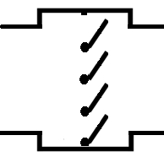
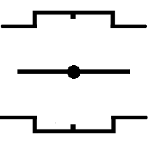






System fire safety operational type. Static, Transient, Dynamic.
Space Type
Risk
Time
Operation
Blade types DP (AD: L)
Power and Fire Signals
Protected Corridor or Lobby
30-120 minutes
Automatic activated to closed position by fire alarm activation
Power Supply. Fire Alarm Interface.
Sleeping, Clinical
30-120 minutes
Automatic activated to closed position by fire alarm activation
Power Supply. Fire Alarm Interface.
Phased Evacuation
30-120 minutes
Automatic activated to closed position by fire alarm activation
Power Supply. Fire Alarm Interface.
Simultaneous Evacuation
30-120 minutes
Activated by fusible link at 72oc to closed position
No requirement
Power Critical supplies
30-120 minutes
Activated by fusible link at 72oc to closed position
No requirement
30-120 minutes
Automatic activated to closed position by fire alarm activation
Fire Fighting
Power Supply. Fire Alarm Interface.
Blade type must be chosen to ensure that the Part L Specific fan powers work
Ve – Vertical
Smoke (S)
Fire (E)
Insulation (I)
Radiance (W)
Parallel
Blade
Opposed
blade
Single
blade
Fusible Link Shutter
Ho - Horizontal
Notes:
Paul to change images

Slide 17
System fire safety operational type. Static, Transient, Dynamic.
Space Type
Risk
Time
Operation
Blade types DP (AD: L)
Power and Fire Signals
Protected Corridor or Lobby
30-120 minutes
Automatic activated to closed position by fire alarm activation
Power Supply. Fire Alarm Interface.
Sleeping, Clinical
30-120 minutes
Automatic activated to closed position by fire alarm activation
Power Supply. Fire Alarm Interface.
Phased Evacuation
30-120 minutes
Automatic activated to closed position by fire alarm activation
Power Supply. Fire Alarm Interface.
Simultaneous Evacuation
30-120 minutes
Activated by fusible link at 72oc to closed position
No requirement
Power Critical supplies
30-120 minutes
Activated by fusible link at 72oc to closed position
No requirement
30-120 minutes
Automatic activated to closed position by fire alarm activation
Fire Fighting
Power Supply. Fire Alarm Interface.
Blade type must be chosen to ensure that the Part L Specific fan powers work
Ve – Vertical
Smoke (S)
Fire (E)
Insulation (I)
Radiance (W)
Parallel
Blade
Opposed
blade
Single
blade
Fusible Link Shutter
Ho - Horizontal
Notes:
Paul to change images

Slide 18

The Process required for descriptive Fire Dampers
classification for product fire safety type
Establish descriptive classification for product fire safety type
System fire safety operational type. Static, Transient, Dynamic.
Establish the Passive fire safety classification types
Create the Passive fire safety systems Seal registers
E120(ho i↔o )S - (300Pa)
Supporting construction compatibility type /P.F safety seal type
Gateway points
Example:
Refuge in protected corridor with supply air and extract.
Notes:
Paul to change images

Slide 19
Classification for product fire safety type
Direction of Fire
Plane of Fire
Space Type
Risk
Time
Operation
Blade types DP (AD: L)
Cycling
Protected Corridor or Lobby
AD: B. Method 4
(i ↔ o)
Up to C10000
E.S
30-120
Ve or Ho
AD: B. Method 4
Up to C10000
Sleeping, Clinical
E.S
30-120
(i ↔ o)
Ve or Ho
AD: B. Method 4
Up to C10000
Phased Evacuation
E.S
30-120
(i ↔ o)
Ve or Ho
Simultaneous Evacuation
E
30-120
AD: B. Method 1
(i ↔ o)
Ve or Ho
Power Critical supplies
AD: B. Method 1
E
30-120
(i ↔ o)
Ve or Ho
AD: B. Method 4
Up to C10000
Fire Fighting
E.S
30-120
(i ↔ o)
Ve or Ho
Blade type must be chosen to ensure that the Part L Specific fan powers work
Ve – Vertical
Smoke (S)
Fire (E)
Insulation (I)
Radiance (W)
Parallel
Blade
Opposed
blade
Single
blade
Fusible Link Shutter
Ho - Horizontal
Notes:
Paul to change images

Slide 20
Classification for product fire safety type
Direction of Fire
Plane of Fire
Space Type
Risk
Time
Operation
Blade types DP (AD: L)
Cycling
Protected Corridor or Lobby
AD: B. Method 4
(i ↔ o)
Up to C10000
E.S
30-120
Ve or Ho
AD: B. Method 4
Up to C10000
Sleeping, Clinical
E.S
30-120
(i ↔ o)
Ve or Ho
AD: B. Method 4
Up to C10000
Phased Evacuation
E.S
30-120
(i ↔ o)
Ve or Ho
Simultaneous Evacuation
E
30-120
AD: B. Method 1
(i ↔ o)
Ve or Ho
Power Critical supplies
AD: B. Method 1
E
30-120
(i ↔ o)
Ve or Ho
AD: B. Method 4
Up to C10000
Fire Fighting
E.S
30-120
(i ↔ o)
Ve or Ho
Blade type must be chosen to ensure that the Part L Specific fan powers work
Ve – Vertical
Smoke (S)
Fire (E)
Insulation (I)
Radiance (W)
Parallel
Blade
Opposed
blade
Single
blade
Fusible Link Shutter
Ho - Horizontal
Notes:
Paul to change images

Slide 21
The Process required for descriptive Fire Dampers
Supporting construction compatibility type /P.F safety seal type
E120(ho i↔o )S - (300Pa)
classification for product fire safety type
The installation/maintenance access types.
Vertical Symmetrical Flexible – EN520
Vertical or Horizontal Rigid – Concrete/ Block > 650 kg/m3
All other types are classed as ‘Other’ and required appropriate test data.
Establish fire safety descriptive supporting construction compatibility type
Establish the passive fire safety seal descriptive type
Gateway points
Example:
Refuge in protected corridor with supply air and extract.
Notes:
Paul to change images

Slide 22
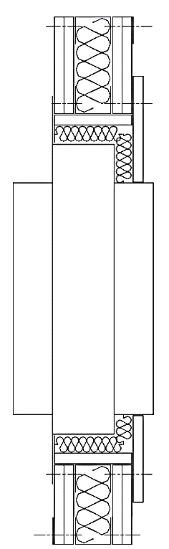
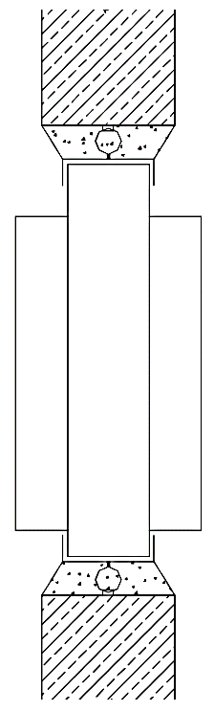
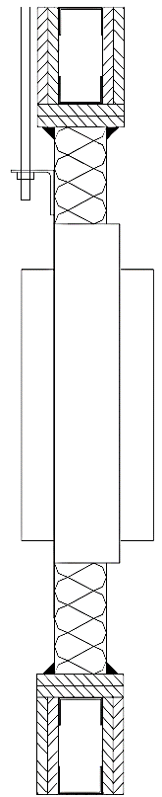
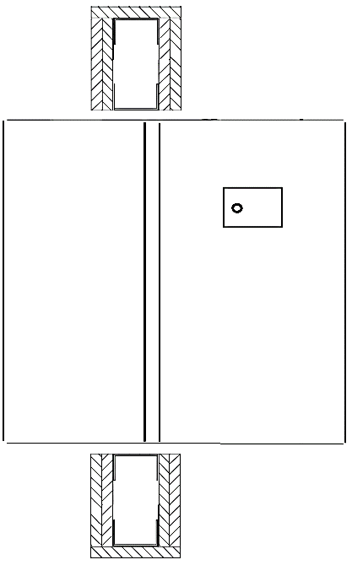
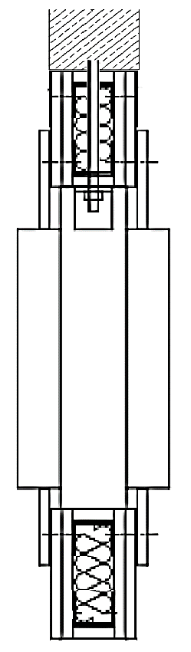
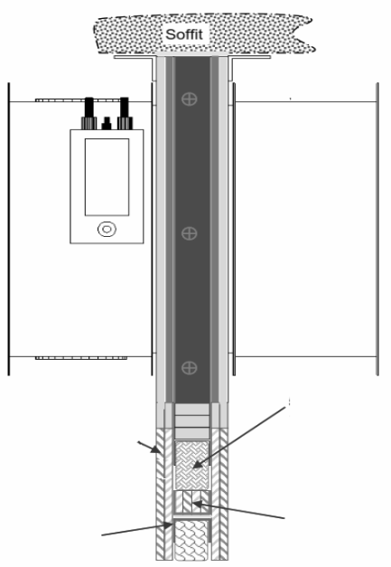
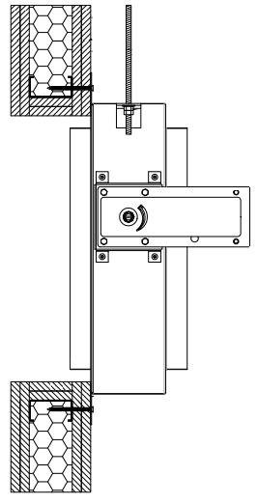
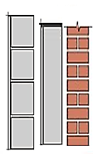
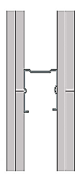
Supporting construction compatibility type /P.F safety seal type
Classification
E120 (VE i ↔ o)S
C10000
Frame Type
Protected Corridor or Lobby
Flanged
Cast In
Ablative Batt
Plastered In
Cleats In Wall
Reverse Deflection Head
On Wall
Vertical Symmetrical Flexible – EN520
Vertical or Horizontal Rigid – Concrete/ Block > 650 kg/m3
Wall System Type
All other types of wall or floor are classed as “Other” and require supporting test and classification data.
Wall Thickness
Check with the damper manufactures DOP and compare with other wall system products DOP to ascertain the thickness for all system components (I.E. Doors, FR Ducts, Flues, Glass Screens, Pipework, Busbar, FR Cable Containment Systems)
Wall Thickness is specific to test arrangement
EN520 & Mineral Wool
4:1 Sand and Cement
Test Specific Batt & Mastic
Gypsum Plaster specific to test
EN520 overboard
Test Specific Wall Kit
EN520 Aperture Framed
Aperture Framing & Passive Seal specific to test arrangement
Seal Type
Notes:
Paul to change images

Slide 23
Supporting construction compatibility type /P.F safety seal type
Classification
E120 (VE i ↔ o)S
C10000
Frame Type
Protected Corridor or Lobby
Flanged
Cast In
Ablative Batt
Plastered In
Cleats In Wall
Reverse Deflection Head
On Wall
Vertical Symmetrical Flexible – EN520
Vertical or Horizontal Rigid – Concrete/ Block > 650 kg/m3
Wall System Type
All other types of wall or floor are classed as “Other” and require supporting test and classification data.
Wall Thickness
Check with the damper manufactures DOP and compare with other wall system products DOP to ascertain the thickness for all system components (I.E. Doors, FR Ducts, Flues, Glass Screens, Pipework, Busbar, FR Cable Containment Systems)
Wall Thickness is specific to test arrangement
EN520 & Mineral Wool
4:1 Sand and Cement
Test Specific Batt & Mastic
Gypsum Plaster specific to test
EN520 overboard
Test Specific Wall Kit
EN520 Aperture Framed
Aperture Framing & Passive Seal specific to test arrangement
Seal Type
Notes:
Paul to change images

Slide 24
The Process required for descriptive Fire Dampers
The installation/maintenance access types.
Supporting construction compatibility type /P.F safety seal type
Establish the Passive Fire seal installation & maintenance access and sequence
Add the Passive Fire Seals BWIC information to the seal register
Gateway points
Confirm spatial coordination of systems using prescriptive products
Example:
Refuge in protected corridor with supply air and extract.
Notes:
Paul to change images

Slide 25
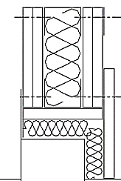

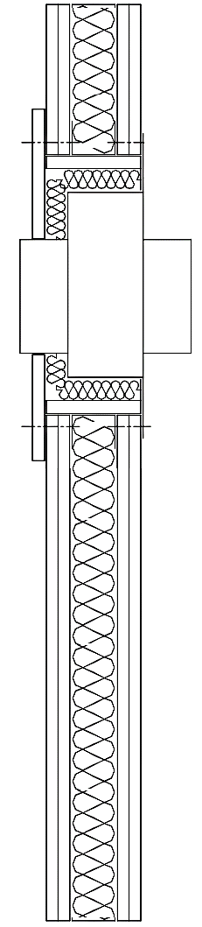
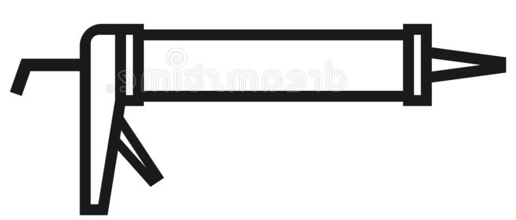
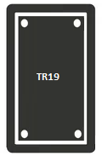

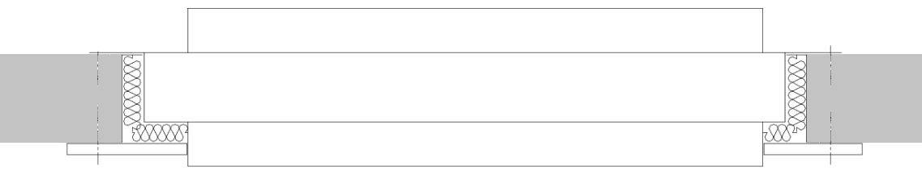
The installation/maintenance access types
Classification
Damper
Frame
Blade types DP (AD: L)
Wall
Position
Wall Type
Wall System Thickness
Seal Type
E120 (VE i ↔ o)S
C10000
Protected Corridor or Lobby
Symmetrical Flexible – EN520
EN520 & Mineral Wool
Flanged
Opposed
Ve – Vertical
122mm (example determination)
Duct
Duct
Installation Requirements
* Distance from slab 75mm min or distance as required by the fire wall for its tested requirements
*
500mm-600mm access
500mm-600mm access
500mm to form break away joint
500mm to form break away joint
500mm-600mm access
*
*
Seal Access
Break Away Joints
Notes:
Paul to change images

Slide 26
Descriptive Complete – Fire Damper
Classification
Damper
Frame
Blade types DP (AD: L)
Wall
Position
Wall Type
Wall System Thickness
Seal Type
E120 (VE i ↔ o)S
C10000
Protected Corridor or Lobby
Symmetrical Flexible – EN520
EN520 & Mineral Wool
Flanged
Opposed
Ve – Vertical
122mm (example determination)
Classification
E | 120 | VE | i ↔ o | S | C10000
Notes:
Paul to change images

Slide 27
Scheduling of products – Fire Dampers

Slide 28
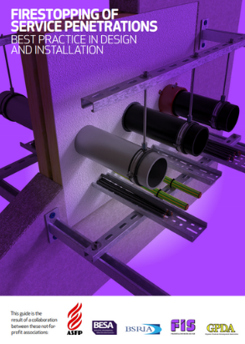
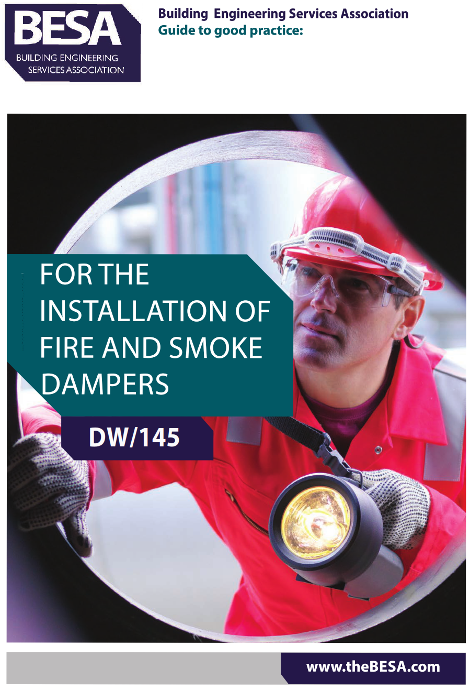
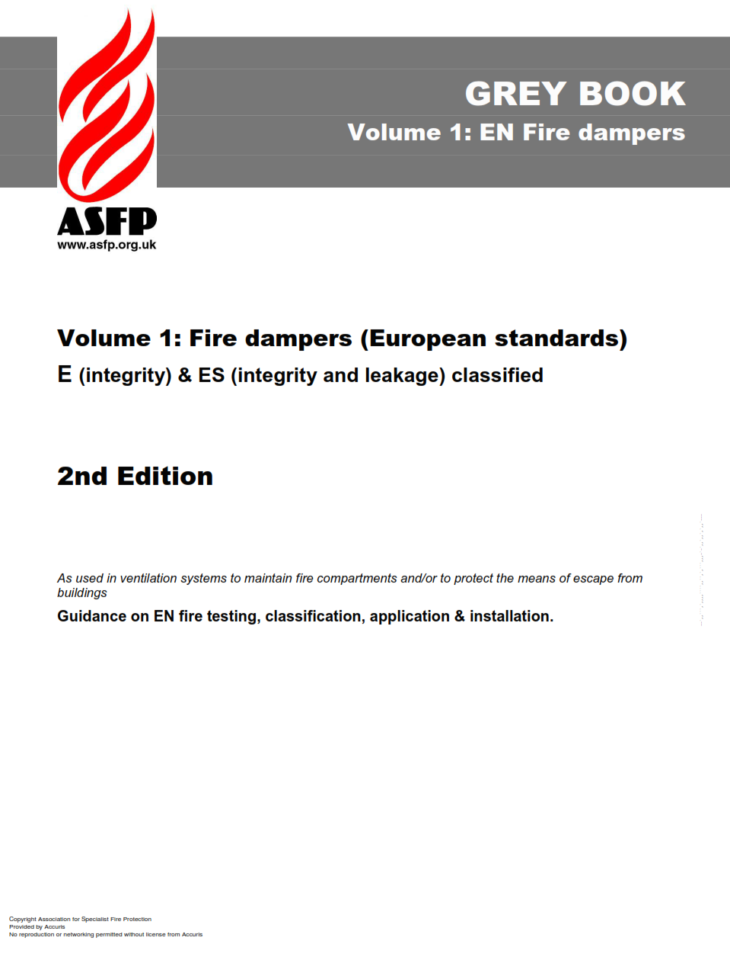
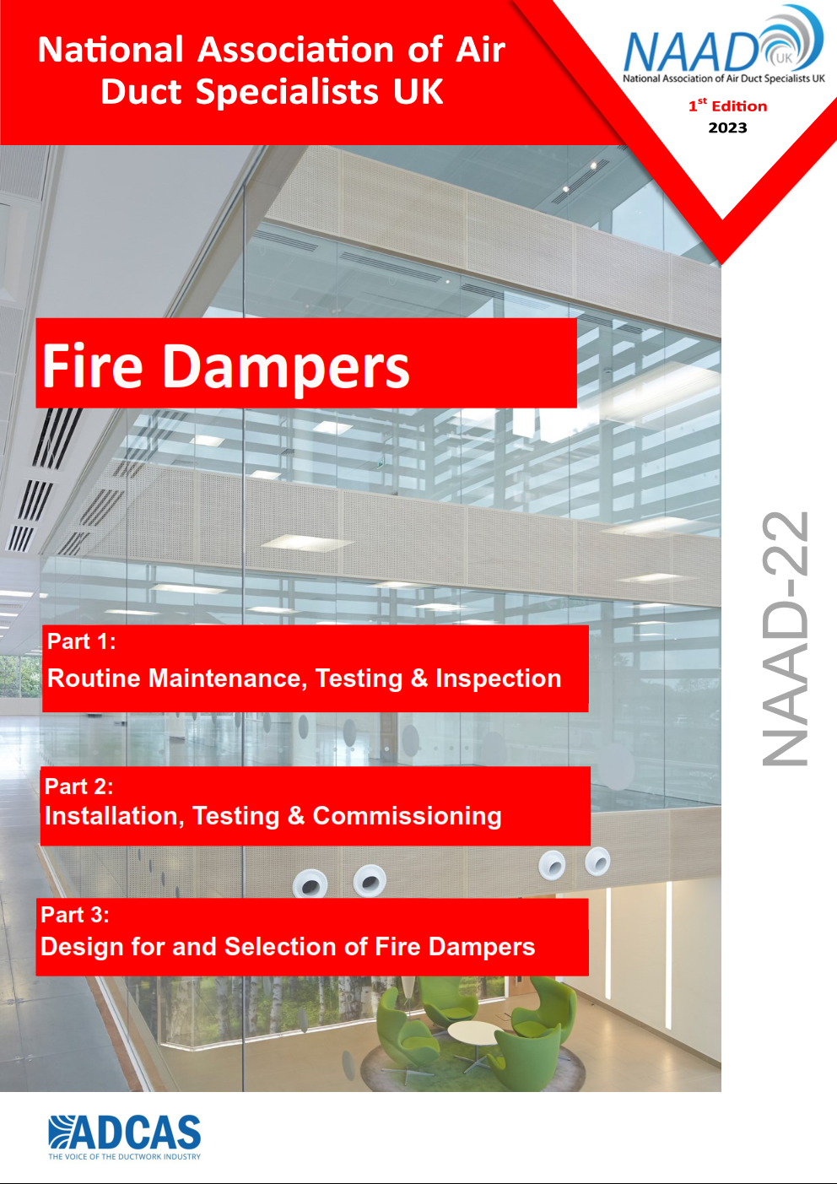
Further Reading
Fire Stopping of Service Penetrations
Best Practice in Design and Installation
Free Download from ASFP, FIS, BSRIA and BESA
DW 145
For the installation of fire and smoke dampers.
Available for download from BESA
ASFP Grey Book (2nd Edition)
Volume 1:
Fire dampers (European standards) E (integrity) & ES (integrity and leakage) classified
Available for download from ASFP
NAAD22
Fire Dampers
Available for download from NAADUK

Slide 29
Disclaimer
The Passive Fire Knowledge Group (PFKG) is a not-for-profit collaborative group of specialists working within various fields of passive fire protection.
The aim of the PFKG is to promote passive fire protection guidance and best practice and improve the delivery of well designed, specified and installed passive fire protection.
Information is produced by subject matter experts, peer reviewed and signed off by the PFKG Governance group before publication.
All information contained on the PFKG website and its publications, video libraries, and training resources is for general information and guidance only and does not purport to be and should not be considered as a professional or legal advice. Whilst all reasonable steps have been taken to ensure that the information contained on the PFKG website and within its publications is correct to the best of our knowledge, complete accuracy cannot be guaranteed, and the information contained within it may be incomplete or may be due for updates or changes.
Accordingly, the PFKG, its subject matter experts, and the co-publishers make no warranties or representations of any kind as to the content or accuracy of its information and, to the maximum extent permitted by law, accept no liability whatsoever for the same including, without limit, any technical, editorial, typographical or other errors or omissions in or misinterpretations of the information provided on their website, and for direct, indirect or consequential loss, business interruption, loss of business opportunity, loss of profits, production, contracts, goodwill or anticipated savings.
Any person making use of the PFKG’s information does so at his or her own risk and it is recommended that they seek professional advice whenever appropriate.
In no event will the PFKG, its subject matter experts, and its co-publishers be liable to anyone for any decision made or action taken in reliance on the information published on the PFKG website or for any consequential, special, or similar damages, even if advised of the possibility of such damages.

